Slide 1
Details for Drawing Packages (Content and GD&T)
Special Topic Lecture
February 26, 2018
UTSA

Slide 2
Geometric Dimensioning and Tolerancing (enough to get you to a working level, but not an expert)
What and Why?
Datum Reference
Feature Control Frame
Material Conditions
Locational Tolerances
Profile/runout/orientation/form tol.
Conversion (positional to coordinate)

Slide 3
History
Introduced by Stanly Parker (Scotland, 1930’s)
Use proliferated during WW II because the need of high production quantities from numerous shops
Designer could discuss with manufacturing personnel what features were to be contacted to establish centerlines that were used on drawings to locate features such as holes and keyways, but a system was needed to get it on paper!
Greatly reduced the cost of “make overs” or need for in shop modifications

Slide 4
What is GD & T ?
It is a compilation of symbols and rules that effectively describe and control
dimensioning and tolerancing for all
drawings. It is documented in ASME
Y14.5 (Y14.8 for castings and forgings)

Slide 5
Why use GD & T ?
Simple and efficient method for describing tolerancing mandated
by the designer of the part
Eliminates ambiguities as to what datum features are to be contacted
to establish the datum planes and/or datum axis that are use for
locating features (all inspectors get the same results)
Simplifies inspection because hard gages can be utilized and simplifies
Inspection for production quantities
Forces the designer to totally consider function, manufacturing
process,and inspection methods. The result is larger tolerances
that guarantee function, but reduce manufacturing and inspection costs.

Slide 6
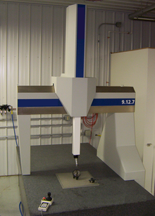
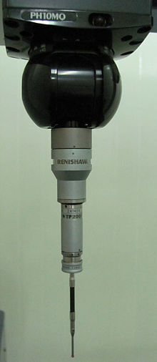
Coordinate Measurement Machine - CMM
3-Axis Control
Stable Base
Sensitive Contact Probe

Slide 7
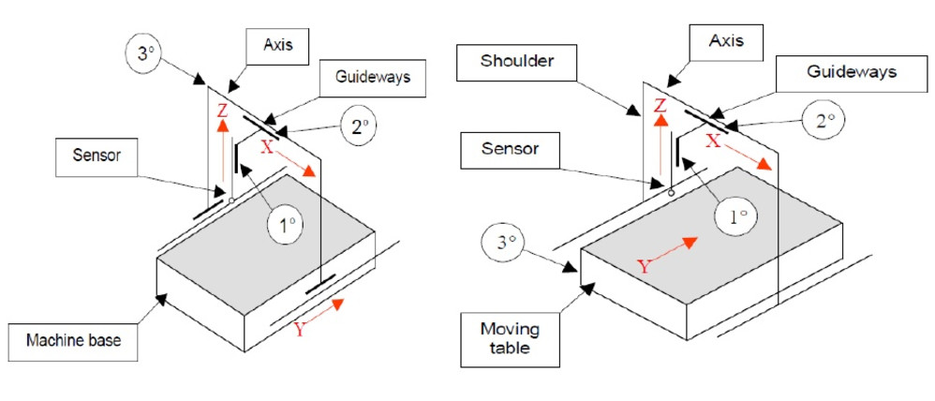
Fixed and Moving Bridge

Slide 8
https://www.youtube.com/watch?v=umtgJNiWyEw

Slide 9
“Old” Drawing with GD&T*
* Geometric Dimensioning and Tolerancing

Slide 10
“New” Drawing with GD&T*
* Geometric Dimensioning and Tolerancing

Slide 12
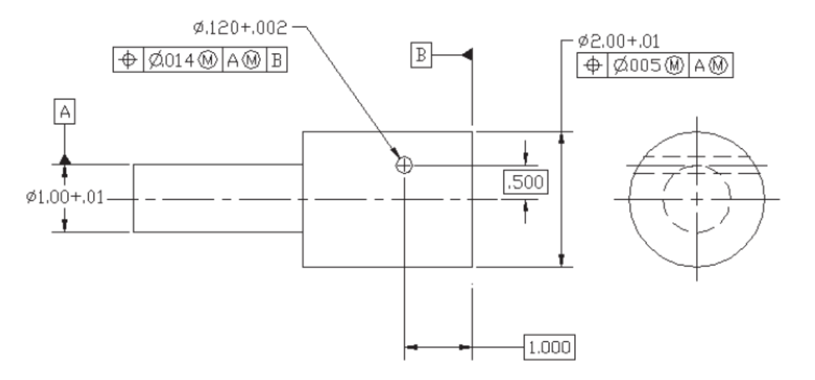
Questions Answered with “New”

Slide 13
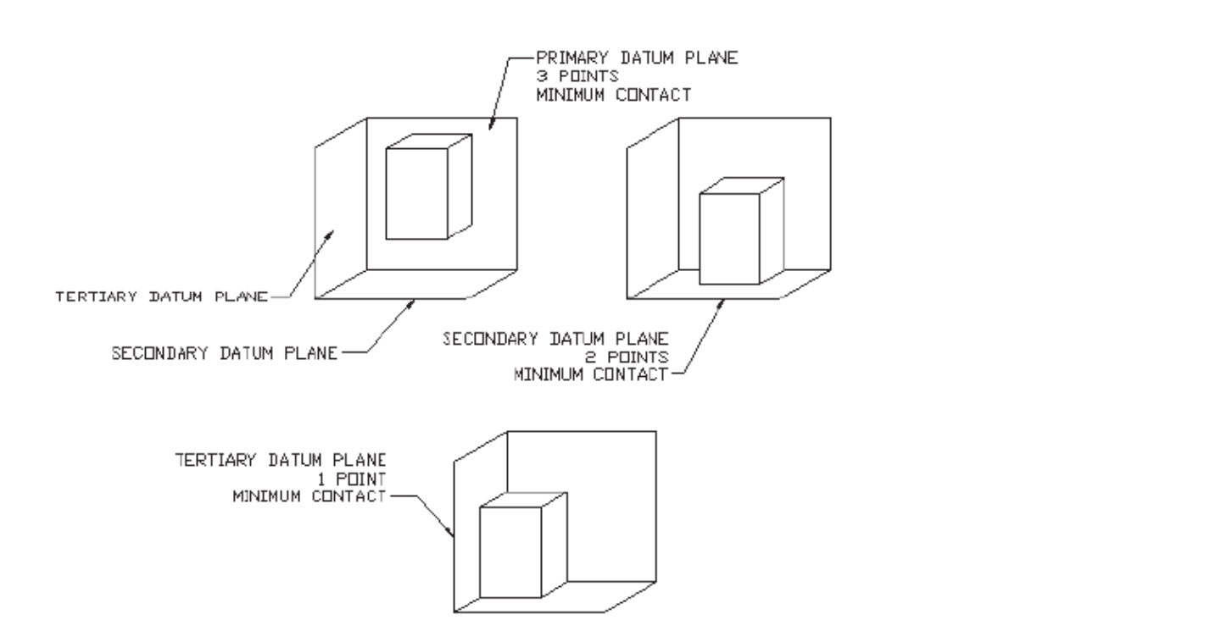
Primary, Secondary, and Tertiary
Datum Planes

Slide 15
Special Fixtures such as highly
Polished stone or stable metals

Slide 17
Feature Control Frame

Slide 18
Taylor Principle
(envelope principle)
If you dimension like this,
how is it interpreted?

Slide 19
Maximum Material Condition
Refers to the envelop size or mating size at the maximum material size (largest external dimensions and smallest internal conditions).
This is the “part material state” to which tolerancing will be applied.

Slide 21
Least Material Condition
Refers to the envelop size or mating size at the minimum material size (smallest external dimensions and largest internal conditions).
This is the “part material state” to which tolerancing will be applied.

Slide 26
Positional Tolerance for Holes

Slide 28
Positional Tolerance for Keyway

Slide 32
Run Out Tolerances

Slide 33
FIM=full indicator movement
[RFS] (regardless of feature size)
(multiple measurements)

Slide 34
These are left in place for full rotation

Slide 36
Perpendicularity of a feature of size axis
at MMC with datum feature of size at MMC

Slide 48
Good Dimensioning (Conventional Practice)
The keys to good dimensioning are:
Choice of dimensions
Placement of dimensions
Technique of dimensioning
Specifying dimension tolerances

Slide 49
Choice of Dimensions
The dimensions you specify define how the object is manufactured:
Dimension first for function and then review seeking improvements for production/manufacturing purposes such as manufacturability, inspection, etc.
Do not give superfluous dimensions
Only those dimensions that are needed to manufacture and inspect the object are to be included on the drawing
Each dimension should appear only once; do not repeat dimensions in different views.

Slide 50
Placement of Dimensions
Follow accepted standards so that dimensions are legible, easy to find, and easy to interpret.
The spacing of dimensions lines must be uniform throughout the drawing.

Slide 51
Placement of Dimensions
Do’s & Don’t’s
Avoid dimensions on the object itself
Avoid dimensioning to hidden lines
Do group dimensions around a central view

Slide 52
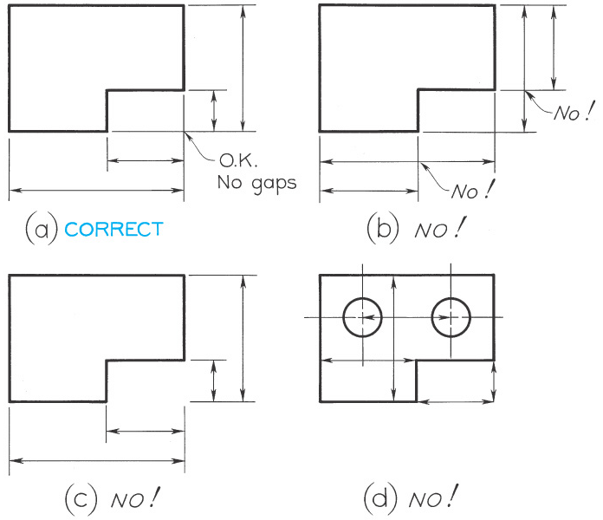
Placement of Dimensions
Conventional practice for placement of dimension and extension lines.

Slide 53
Technique of Dimensioning
Follow accepted standards & practices for the appearance of lines, spacing of dimension lines, size of arrowheads, etc. so that others may correctly interpret your drawing.

Slide 54
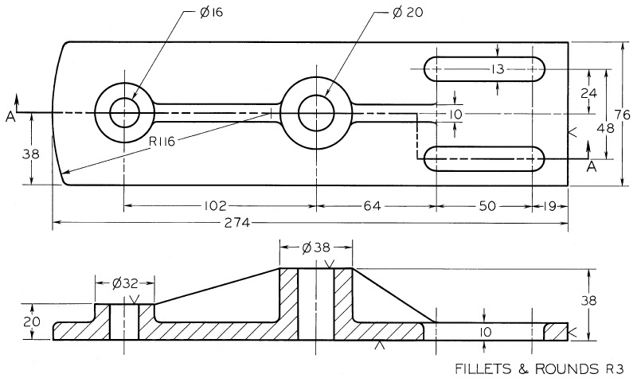
Lines Used in Dimensioning
A dimension line is a thin, dark, solid line terminated by arrowheads that indicate the direction and extent of a dimension.

Slide 55
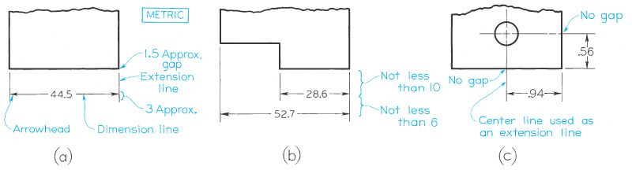
Lines Used in Dimensioning
An extension line is a thin, dark, solid line that extends from a point on the drawing to its associated dimension line.
A gap of ~1.5 mm should be left between the extension line and the point on the part.

Slide 56
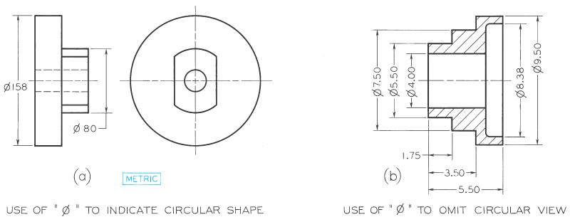
Lines Used in Dimensioning
A center line is a thin, dark, solid line that alternates long and short dashes to locate holes and other symmetrical features.

Slide 57
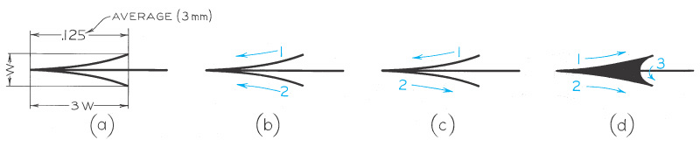
Lines Used in Dimensioning
Arrowheads are used to indicate the extent of a dimension. They should be uniform in size & style throughout the drawing.

Slide 58
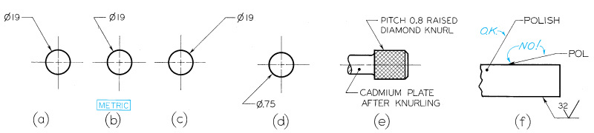
Lines Used in Dimensioning
An leader is a thin, solid line directing attention to a note or dimension. A leader starts with an arrow or dot:
Use an arrow when the leader can point to a specific line in the drawing such as the edge of a surface
Use a dot when the leader is locating a feature within the outline of the part

Slide 59
Dimension Tolerances
A tolerance is required for every dimension on a drawing. Definition: a tolerance is the total amount that the feature on the actual part is allowed to vary from what is specified by the dimension.
A general tolerance applicable to most dimensions can be specified in the title block.
Example: “All tolerances +/- 0.01 inches unless otherwise noted”.
A tolerance for a particular dimension may be specified by limit dimensions or plus and minus dimensions.
Example: “1.500 +/-.003” or “1.252/1.248”

Slide 60
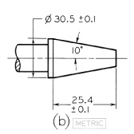
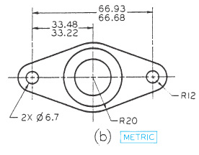
Dimension Tolerances: Examples

Slide 61
Dimension Tolerances
The purpose of dimension tolerances:
Allows a range of acceptable variability on the dimensions of a part
Assures that parts interchanged between assemblies will fit properly
Allowing parts be manufactured to prescribed tolerances rather than exact dimensions permits efficient and economical manufacturing. In general: high precision means high cost!

Slide 62
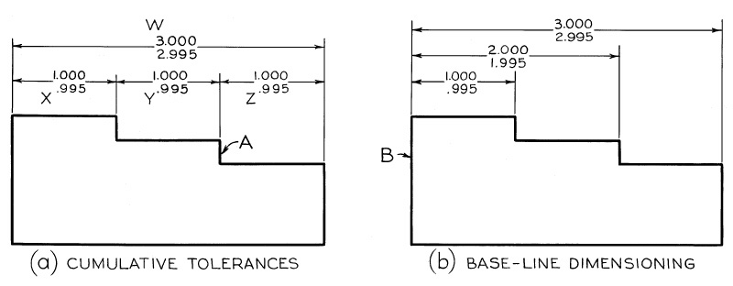
Dimension Tolerances
Tolerance stacking is to be avoided by dimensioning with respect to a datum.

Slide 63
Do’s & Don’ts of Dimensioning
Do not trust the automatic creation & placement of dimensions done for you by CAD software.
Each dimension should be given clearly so that it can be interpreted only one way
Dimensions should not be duplicated
Dimensions should be given so that the machinist will not have to calculate, scale, or assume any dimensions.

Slide 64
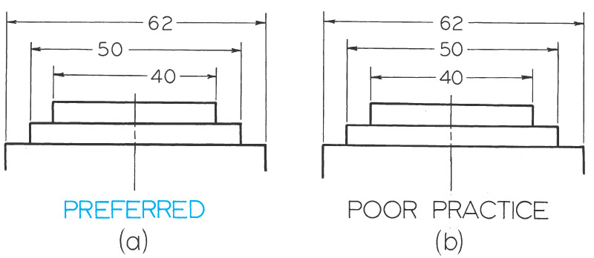
Dimensioning: Examples

Slide 65
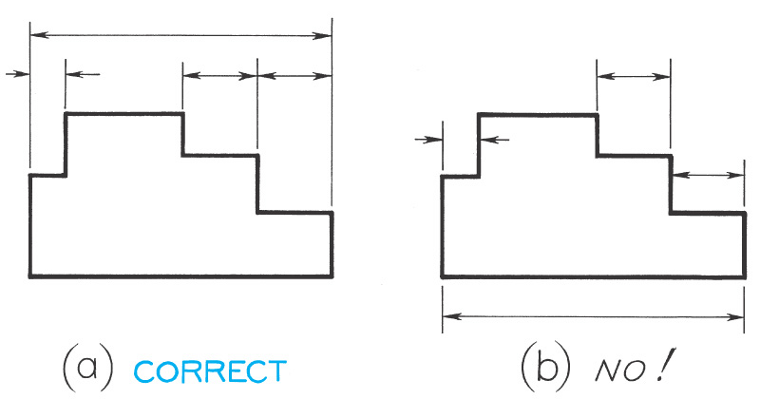
Dimensioning: Examples

Slide 66
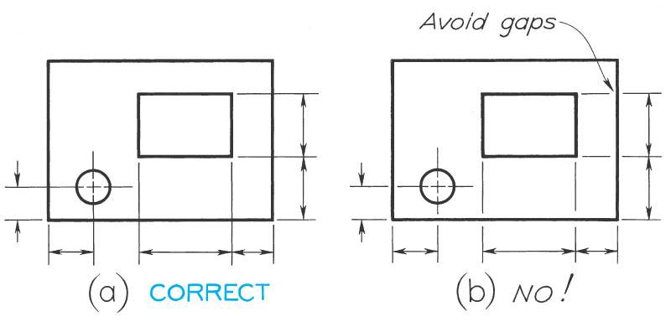
Dimensioning: Examples

Slide 67
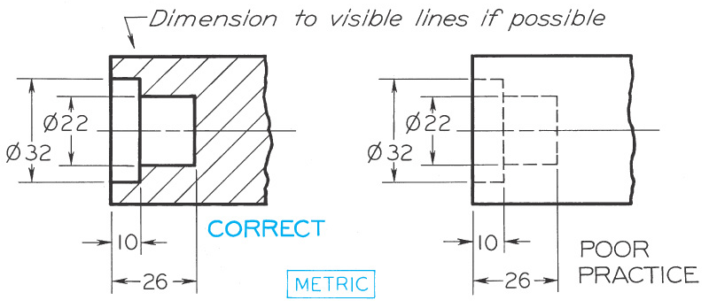
Dimensioning: Examples

Slide 68
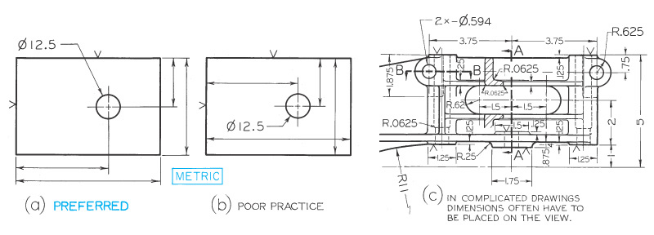
Dimensioning: Examples

Slide 69
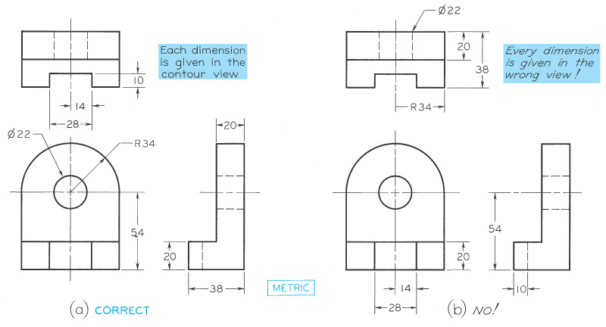
Dimensioning: Examples

Slide 70
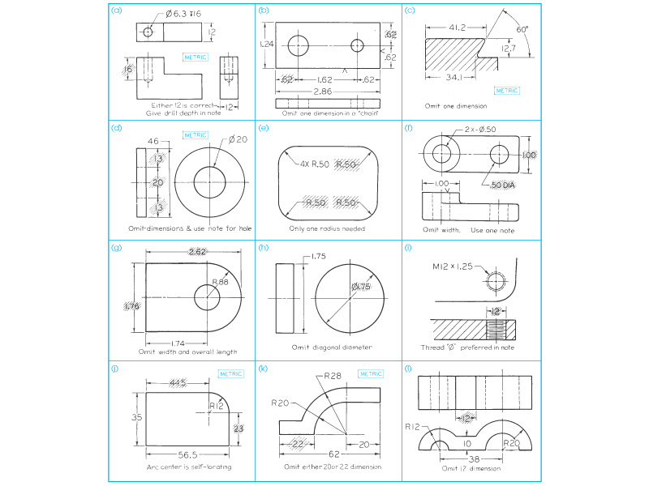
Dimensioning: Examples

Slide 71
Dimensioning: Examples

Slide 72
Dimensioning: Examples

Slide 73
Dimensioning: Examples

Slide 74
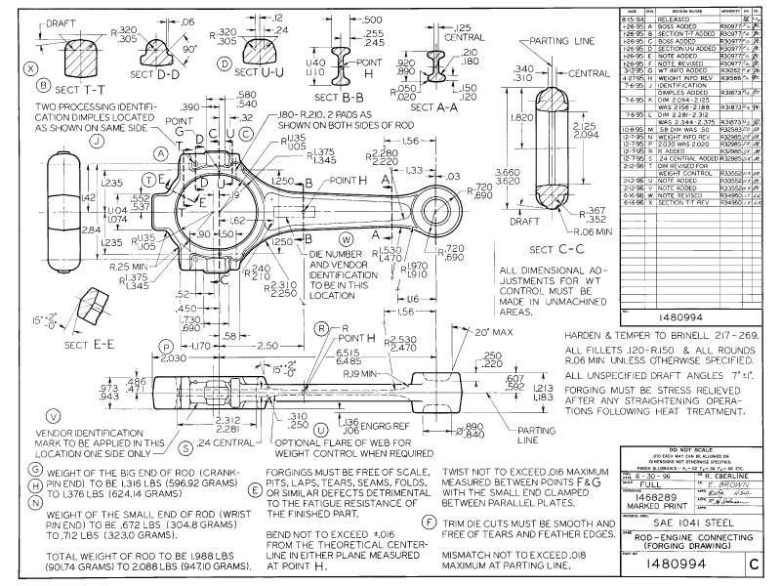
Dimensioning: A real drawing

